Slide 1
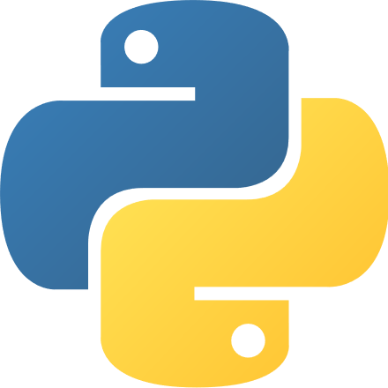
What is Python?
High level programming language
First released in 1991 by Guido van Rossum
Object-oriented, imperative, functional and procedural
Supported by many operating systems
Commonly used for computation in the field of artificial intelligence and machine learning

Slide 2
Why Python?
Wide scientific community:
Many different helpful libraries
Open source frameworks and tools
Python Package Index (PyPI): 433,519
Easy to learn/use
Simplicity and consistency,
High-level language: ideas can be implemented quickly
Flexibility,
Platform independence

Slide 3
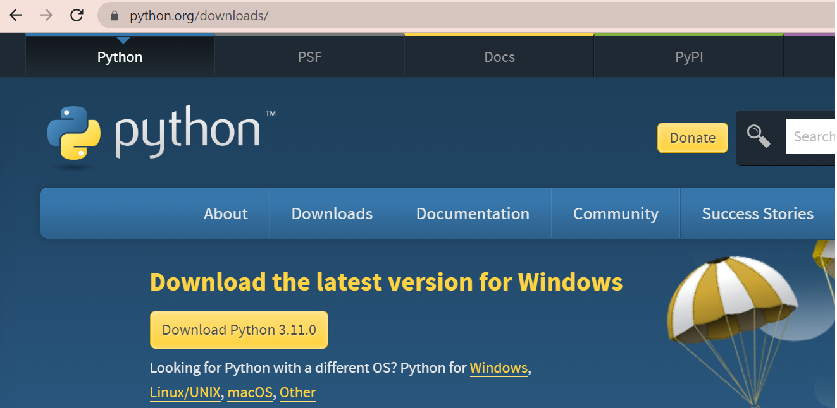
Installation
Windows: visit https://www.python.org/downloads/ to download Python (recommended version: 3.9 or above)
Linux: run the following command in terminal
sudo apt-get install python3.9

Slide 4
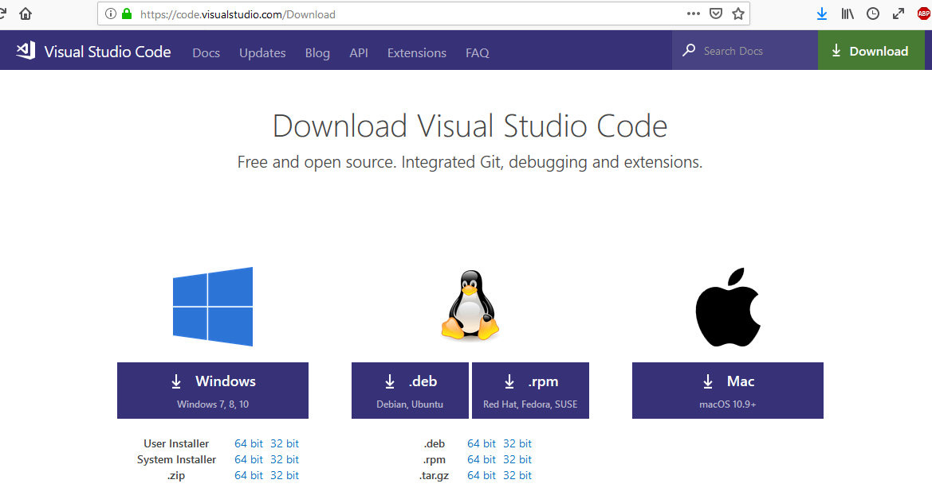
Installation IDE
The choice of the IDE is up to you. I nevertheless recommend VS Code and will provide instructions for this IDE.
To download VS Code, visit https://code.visualstudio.com/Download

Slide 5

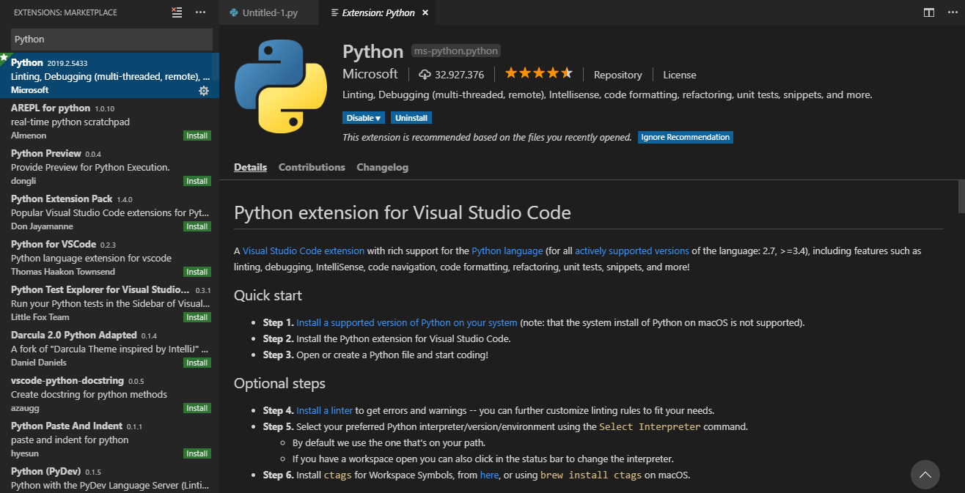
Setup VS Code
Open the „Extensions“ view by:
Selecting „View“ -> „Extensions“
CTRL + Shift + X
Search and install „Python“

Slide 6
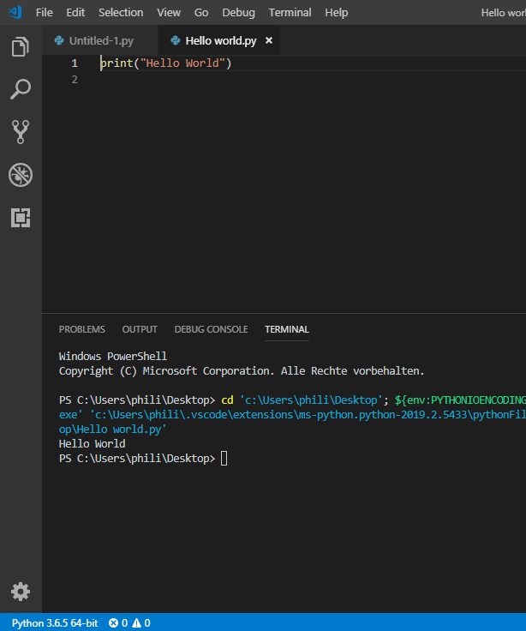
VS Code (Python script)
Create a new file (File - New File)
Save the file (File-> Save As…)
Make sure it is of type python (.py)
Scripts can be executed with F5 (debug mode), or right click + “Run Python file in terminal”
To check your installation: print “Hello world!”

Slide 7
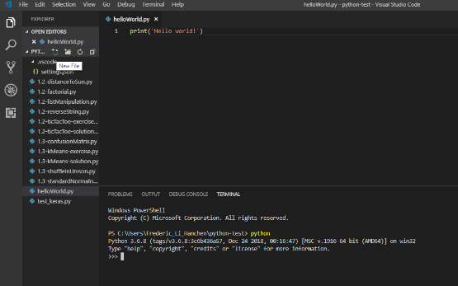
How to run Python code?
Two main ways to execute Python code:
Start the Python interpreter by typing > python in command line
Write a Python script (.py file) then execute it by typing > python name_of_the_script.py in command line

Slide 8
Python Identifiers
A Python identifier is a name used to identify a variable, function, class, module or other object:
Starts with a letter A to Z or a to z or an underscore (_) followed by zero or more letters, underscores and digits (0 to 9).
Case sensitive.
When using a Python identifier, avoid:
Using a Python keyword.
Starting or ending the identifier with underscore (_) unless you have a specific reason to do so.
Python is a dynamically typed language:
No need to declare any variable type.
The type of a variable can be changed in the same script.
E.g.: aVariable = 0 … aVariable = “Hello world!”

Slide 9
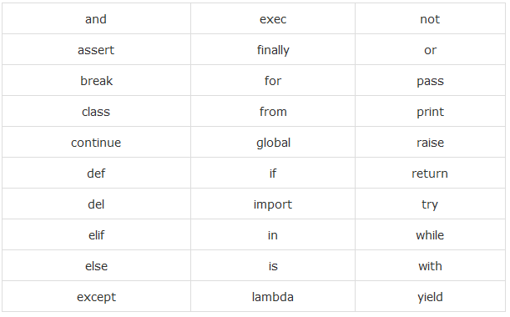
Python keywords
Reserved words (cannot use them as constant or variable)

Slide 10
Naming conventions
https://visualgit.readthedocs.io/en/latest/pages/naming_convention.html
Class names start with an uppercase letter. All other identifiers start with a lowercase letter.
Starting an identifier with a single leading underscore indicates that the identifier is private.
Starting an identifier with two leading underscores indicates a strongly private identifier.
Identifiers which start and end with two trailing underscores are language-defined special names. The most useful examples are:
__init__ which refer to the class constructor
__name__ and __main__ which are used to define a main file: if __name__ == “___main__”: ……

Slide 11
Indentation
In Python, no braces to indicate blocks of code
Denoted by line indentation
Number of spaces in the indentation up to you, but all statements within the block must be indented the same amount
Commonly used indentations: tabs or 4 spaces.
Notes:
mixing spaces and tabs together → error!
no need to use any character to denote an end of line (e.g. “;”)
Block 1
Block 2
Block 3
Block 2, continuation
Block 1, continuation
for idx in range(n):
if B:
Task inside if
Task inside for
Task outside for

Slide 12
Multi-Line Statements
Statements in Python typically end with a new line
Use of the line continuation character (\)
total = item_one + \
item_two + \
item_three
Statements contained within the [], {}, or () brackets do not need to use the line continuation character
days = ['Monday', 'Tuesday', 'Wednesday',
'Thursday', 'Friday']

Slide 13
Quotation
Python accepts single ('), double (") and triple (''' or """) quotes to denote string literals
Start and end same type
Triple quotes are used to span the string across multiple lines
word = 'word'
sentence = "This is a sentence."
paragraph = """This is a paragraph. It is
made up of multiple lines and sentences."""

Slide 14
Comments
A hash sign (#) that is not inside a string literal begins a comment -> whole line is commented (ignored by the interpreter)
Can be used to comment multiple lines in a row
Triple-quoted string is also ignored by Python interpreter and can be used as a multiline comments
#This is a comment
print("Hello World")
'''
This is
a
multirow comment
'''

Slide 15
Basic operations
The operators +, -, * and / work just like in most other languages
The standard comparison operators are written the same as in C:
< (less than)
> (greater than)
== (equal to)
<= (less than or equal to)
>= (greater than or equal to)
!= (not equal to)
Modulo operation: %
Floor division: a // b

Slide 16
Assigning values to variables
Variables do not need explicit declaration to reserve memory space
No type needed
Equal sign (=)
delete entire variables: del *variable name*
# An integer assignment
counter = 100
# A floating point
miles = 1000.0
# A string
name = "John"
# one line
counter, miles, name = 100, 1000.0, "John"
# Assign single value to several variables
a = b = c = 1
# Delete a variable
del a

Slide 17
Standard data types
Python has six standard data types
Numbers
Boolean
String
List
Tuple
Dictionary
For numbers: integer, float, complex
For Booleans: True, False
Note: in Python 3.x, Booleans inherit from integers, i.e. True == 1 and False == 0 will both return True.

Slide 18
Lists
Items separated by commas and enclosed within square brackets ([])
Similar to arrays in C.
Indexing starts at 0
Items can be of different data type
Items can deleted: del
list = [ 'abcd', 786 , 2.23, 'john', 70.2 ]
tinylist = [123, 'john']
print(list) # Prints complete list
print(list[0]) # Prints first element of the list
print(list[1:3]) # Prints elements starting from 2nd till 3rd
print(list[2:]) # Prints elements starting from 3rd element
print(tinylist * 2) # Prints list two times
print(list + tinylist) # Prints concatenated lists

Slide 19
IF statement
x = 1
if x < 0:
x = 0
print('Negative changed to zero')
elif x == 0:
print('Zero')
elif x == 1:
print('Single')
else:
print('More')
Form
if condition :
code block
Elif/else are optional

Slide 20
Loops - For
Iterates over the items of any sequence
Iterate over a slice copy of the entire list with list[:]
list = ['element1', 'element2', 'element3']
for element in list:
print(element)
Iterate over a sequence of numbers: range - function
0
1
2
3
4
*
for i in range(5):
print(i)
* range() returns an iterator, not a list!

Slide 21
Loops - While
The while statement is used for repeated execution as long as an expression is true
Optional else clause: will be executed the first time the expression is false and the loop terminates
i = 0
while i<5:
print(i)
i += 1
else:
print("Finished")
The break statement, like in C, breaks out of the innermost enclosing for or while loop.

Slide 22
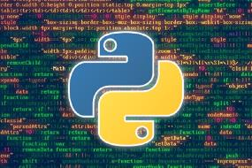
Conclusion
Basic informal introduction to Python
First basic Python exercises
Next week: Data Structures and Functions
Block 1
Block 2
Block 3
Block 2, continuation
Block 1, continuation

Slide 23
Exercise 1
Write a program printNegative which prints all negative elements of an integer or float input list.
Write a program filterOdd which takes a list of integers as input and returns a sub-list of the input containing only its odd elements (tip: the Python modulo operator is %; e.g. 7%2 returns 1).
Write a program removeDuplicate which takes a list of any type as input, and returns a list without any duplicate elements as output.

Slide 24
Exercise 2
Write a function printReverseString which takes a sentence under the string format as input (e.g. "Hello world!") and prints the sentence with words in the reverse order (e.g. "world! Hello").
Tips:
A sentence is an ensemble of words separated by spaces
The Python string methods split and join should be useful for this exercise

Slide 25
Exercise 3
Write a function distanceToSun which asks the user to input the name of a planet of our solar system in command line, and prints the distance between the planet and the Sun in kilometres.
Tips:
Pick the online source of your choice to find distances between planets and the Sun.
Asking for an user input in terminal can be done using the userInput = input("text to display") syntax.
Remember to treat the case where the user input is invalid.
Stopping a function can be done using return

Slide 26
What is Python?
High level programming language
First released in 1991 by Guido van Rossum
Object-oriented, imperative, functional and procedural
Supported by many operating systems
Commonly used for computation in the field of artificial intelligence and machine learning

Slide 27
Why Python?
Wide scientific community:
Many different helpful libraries
Open source frameworks and tools
Python Package Index (PyPI): 433,519
Easy to learn/use
Simplicity and consistency,
High-level language: ideas can be implemented quickly
Flexibility,
Platform independence

Slide 28
Installation
Windows: visit https://www.python.org/downloads/ to download Python (recommended version: 3.9 or above)
Linux: run the following command in terminal
sudo apt-get install python3.9

Slide 29
Installation IDE
The choice of the IDE is up to you. I nevertheless recommend VS Code and will provide instructions for this IDE.
To download VS Code, visit https://code.visualstudio.com/Download

Slide 30
Setup VS Code
Open the „Extensions“ view by:
Selecting „View“ -> „Extensions“
CTRL + Shift + X
Search and install „Python“

Slide 31
VS Code (Python script)
Create a new file (File - New File)
Save the file (File-> Save As…)
Make sure it is of type python (.py)
Scripts can be executed with F5 (debug mode), or right click + “Run Python file in terminal”
To check your installation: print “Hello world!”

Slide 32
How to run Python code?
Two main ways to execute Python code:
Start the Python interpreter by typing > python in command line
Write a Python script (.py file) then execute it by typing > python name_of_the_script.py in command line

Slide 33
Python Identifiers
A Python identifier is a name used to identify a variable, function, class, module or other object:
Starts with a letter A to Z or a to z or an underscore (_) followed by zero or more letters, underscores and digits (0 to 9).
Case sensitive.
When using a Python identifier, avoid:
Using a Python keyword.
Starting or ending the identifier with underscore (_) unless you have a specific reason to do so.
Python is a dynamically typed language:
No need to declare any variable type.
The type of a variable can be changed in the same script.
E.g.: aVariable = 0 … aVariable = “Hello world!”

Slide 34
Python keywords
Reserved words (cannot use them as constant or variable)

Slide 35
Naming conventions
https://visualgit.readthedocs.io/en/latest/pages/naming_convention.html
Class names start with an uppercase letter. All other identifiers start with a lowercase letter.
Starting an identifier with a single leading underscore indicates that the identifier is private.
Starting an identifier with two leading underscores indicates a strongly private identifier.
Identifiers which start and end with two trailing underscores are language-defined special names. The most useful examples are:
__init__ which refer to the class constructor
__name__ and __main__ which are used to define a main file: if __name__ == “___main__”: ……

Slide 36
Indentation
In Python, no braces to indicate blocks of code
Denoted by line indentation
Number of spaces in the indentation up to you, but all statements within the block must be indented the same amount
Commonly used indentations: tabs or 4 spaces.
Notes:
mixing spaces and tabs together → error!
no need to use any character to denote an end of line (e.g. “;”)
Block 1
Block 2
Block 3
Block 2, continuation
Block 1, continuation
for idx in range(n):
if B:
Task inside if
Task inside for
Task outside for

Slide 37
Multi-Line Statements
Statements in Python typically end with a new line
Use of the line continuation character (\)
total = item_one + \
item_two + \
item_three
Statements contained within the [], {}, or () brackets do not need to use the line continuation character
days = ['Monday', 'Tuesday', 'Wednesday',
'Thursday', 'Friday']

Slide 38
Quotation
Python accepts single ('), double (") and triple (''' or """) quotes to denote string literals
Start and end same type
Triple quotes are used to span the string across multiple lines
word = 'word'
sentence = "This is a sentence."
paragraph = """This is a paragraph. It is
made up of multiple lines and sentences."""

Slide 39
Comments
A hash sign (#) that is not inside a string literal begins a comment -> whole line is commented (ignored by the interpreter)
Can be used to comment multiple lines in a row
Triple-quoted string is also ignored by Python interpreter and can be used as a multiline comments
#This is a comment
print("Hello World")
'''
This is
a
multirow comment
'''

Slide 40
Basic operations
The operators +, -, * and / work just like in most other languages
The standard comparison operators are written the same as in C:
< (less than)
> (greater than)
== (equal to)
<= (less than or equal to)
>= (greater than or equal to)
!= (not equal to)
Modulo operation: %
Floor division: a // b

Slide 41
Assigning values to variables
Variables do not need explicit declaration to reserve memory space
No type needed
Equal sign (=)
delete entire variables: del *variable name*
# An integer assignment
counter = 100
# A floating point
miles = 1000.0
# A string
name = "John"
# one line
counter, miles, name = 100, 1000.0, "John"
# Assign single value to several variables
a = b = c = 1
# Delete a variable
del a

Slide 42
Standard data types
Python has six standard data types
Numbers
Boolean
String
List
Tuple
Dictionary
For numbers: integer, float, complex
For Booleans: True, False
Note: in Python 3.x, Booleans inherit from integers, i.e. True == 1 and False == 0 will both return True.

Slide 43
Lists
Items separated by commas and enclosed within square brackets ([])
Similar to arrays in C.
Indexing starts at 0
Items can be of different data type
Items can deleted: del
list = [ 'abcd', 786 , 2.23, 'john', 70.2 ]
tinylist = [123, 'john']
print(list) # Prints complete list
print(list[0]) # Prints first element of the list
print(list[1:3]) # Prints elements starting from 2nd till 3rd
print(list[2:]) # Prints elements starting from 3rd element
print(tinylist * 2) # Prints list two times
print(list + tinylist) # Prints concatenated lists

Slide 44
IF statement
x = 1
if x < 0:
x = 0
print('Negative changed to zero')
elif x == 0:
print('Zero')
elif x == 1:
print('Single')
else:
print('More')
Form
if condition :
code block
Elif/else are optional

Slide 45
Loops - For
Iterates over the items of any sequence
Iterate over a slice copy of the entire list with list[:]
list = ['element1', 'element2', 'element3']
for element in list:
print(element)
Iterate over a sequence of numbers: range - function
0
1
2
3
4
*
for i in range(5):
print(i)
* range() returns an iterator, not a list!

Slide 46
Loops - While
The while statement is used for repeated execution as long as an expression is true
Optional else clause: will be executed the first time the expression is false and the loop terminates
i = 0
while i<5:
print(i)
i += 1
else:
print("Finished")
The break statement, like in C, breaks out of the innermost enclosing for or while loop.

Slide 47
Conclusion
Basic informal introduction to Python
First basic Python exercises
Block 1
Block 2
Block 3
Block 2, continuation
Block 1, continuation

